Slide 1

Thomas P Downes Senior Scientist UW-Milwaukee Center for Gravitation, Cosmology and Astrophysics LIGO Scientific Collaboration
Notes:
"Hi... I lead a team of 8 computing scientists at UW-Milwaukee."
“My team supports researchers in our Center and in the LIGO project as a whole.”
“LIGO has over 1000 members and in February of last year, we announced the first direct detection of gravitational waves.”
“I’ll talk about the role that computing played in the discovery, the parts I'm responsible for and how the lessons I've learned might benefit Mines researchers.”
"A bit of a hard talk to give because this is a new position funded by the NSF and whoever fills this position will be defining it as they go.”
“But I hope to give you a sense of my approach and my strengths. There should be a lot of room for discussion at the end."

Slide 2
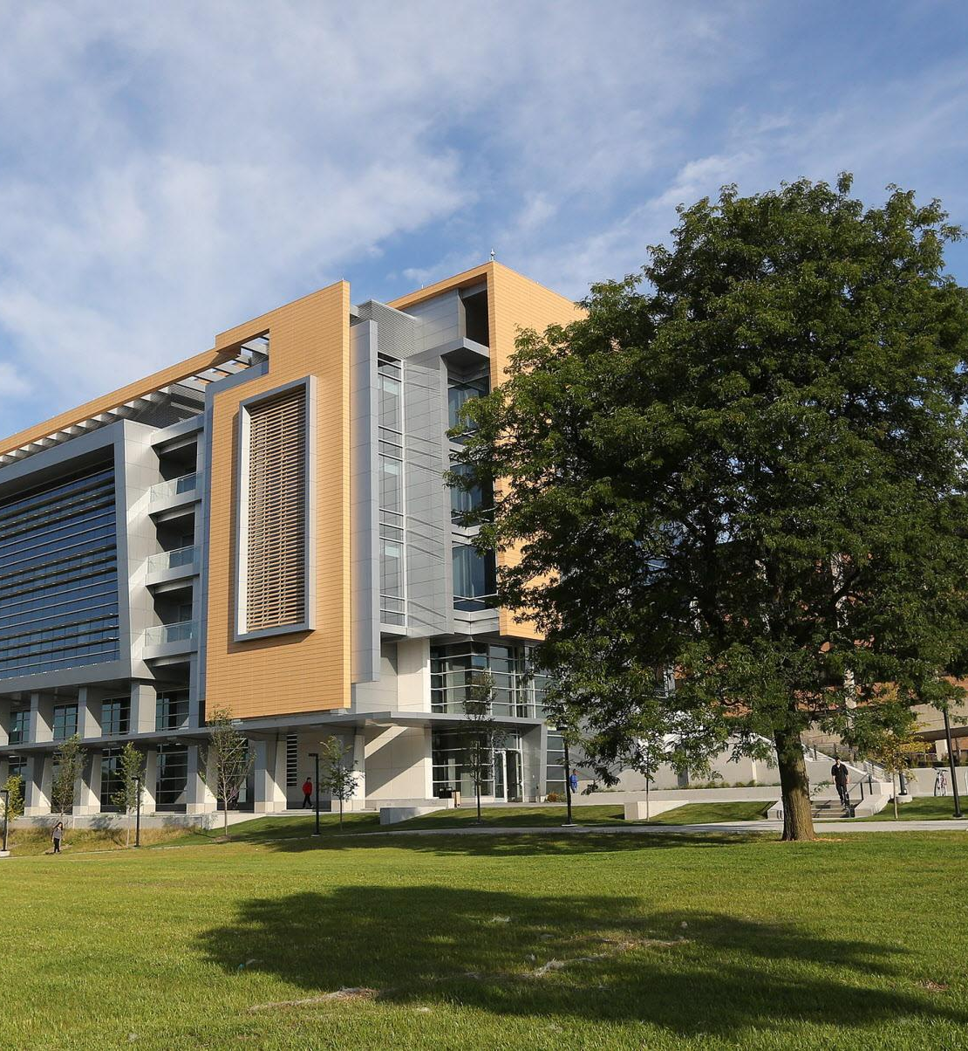
Center for Gravitation, Cosmology and Astrophysics
Physics Department historical campus leader
53 graduate students, post-docs, faculty, staff
Long history of leadership in gravity research and computation
Founding member of LIGO Scientific Collaboration

Slide 3
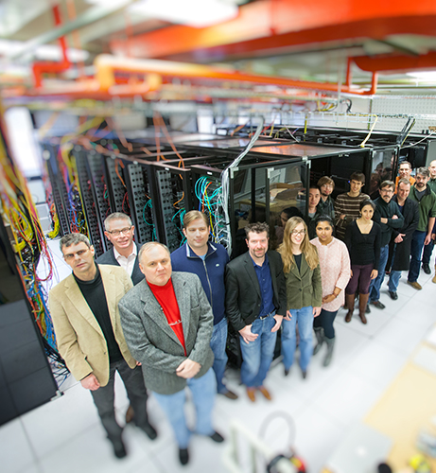
CGCA Computing
Data center: 1700 sq. ft, ~500kW
NEMO computing cluster
Mix of enterprise-level infrastructure and researcher-facing services
Hosts many collaboration services
LIGO wiki, GitLab, continuous integration services
Leader in development of our “low latency” streaming analysis

Slide 4
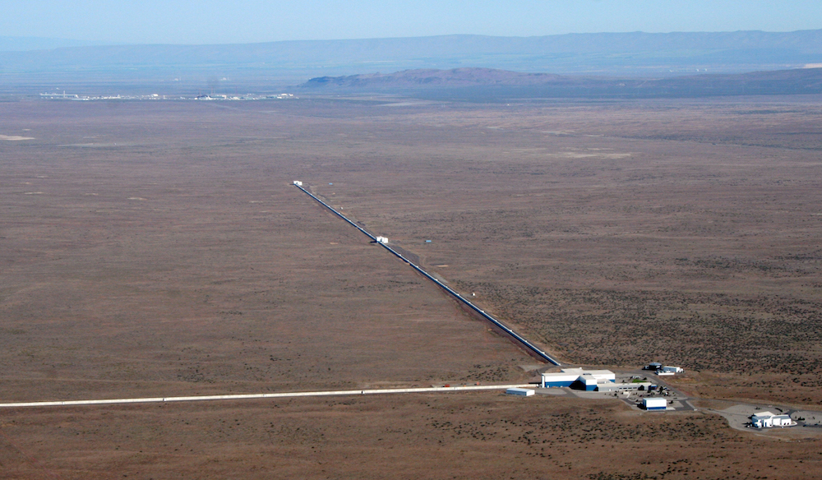
LIGO Interferometer in Hanford, WA (DOE site)

Slide 5
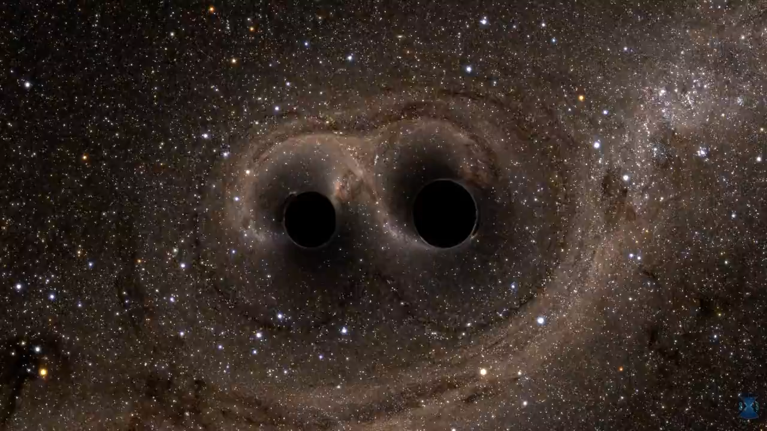
1.3 billion years ago in a galaxy far, far away…
Simulation and video produced by SXS Collaboration

Slide 6
LIGO Discovery on September 14, 2015
09:50:45 UTC (4:50 AM U.S. Central Time)
Black hole merger is simultaneously detected by 2 LIGO Observatories. Detectable portion of merger is 0.2 seconds in duration.
09:53:51 UTC (+3 minutes)
Data is calibrated, transferred to Caltech data centers, analyzed and uploaded to web portal at UW-Milwaukee
10:00:00 UTC (11AM Central European Time)
LIGO scientist at Albert Einstein Institute in Hannover, Germany sees event on web and calls Observatory to inquire about status of instrument

Slide 7

How did we build the software?

Slide 8
The Good and …
Good
Familiar resource scheduler (HTCondor) in wide use in academic research
Results stored in a real database (outside typical experience of researchers)
RESTful interface for code / Browser view for the humans
So-so
Analysis software built out of open source libraries familiar to scientists
Bad
Streaming infrastructure built from scratch (TCP WAN, UDP multicast LAN)
No “health” information include in data stream
WAN connections routinely die

Slide 9
What we’re trying to do
Make these tools highly(-enough) available
Build out of contemporary tools that we can support in the long-term
Professionalize delivery of streaming data to a diverse set of projects
Looking at tools like Kafka, Spark, etc.
… on academic research budgets
organizational structures
purchasing policies
staffing
etc.

